Slide 1


E&C Capital Projects
Construction Change Management
Responsibilities
January 2025

Slide 2
Change Management
Key Discussion Points
Site Inspector must be aware of the change in work and receive a copy of the approved Change Order or Change Directive Site Inspector’s records shall document Contractor’s change in work: Change Orders/RFQ, Change Directive/Time & Material, Potential Claim Site Inspector’s records shall be independent of the Contractor’s Daily Work Records Contract Administrator shall reconcile the Inspector’s Daily Inspection Report and Contractor’s Daily Work Record before preparing the Payment Certificate New Daily Inspection Report template is created to capture the details of the Extra Work performed on a project

Slide 3
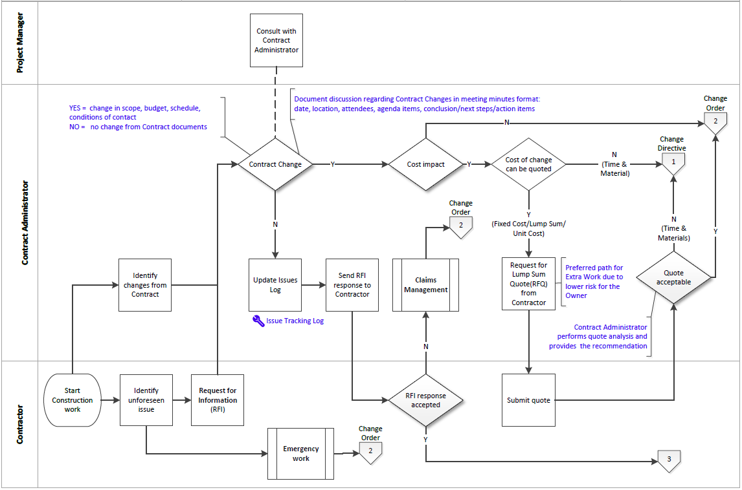
Change Management
Change in work decision: Change Directive vs Change Order

Slide 4
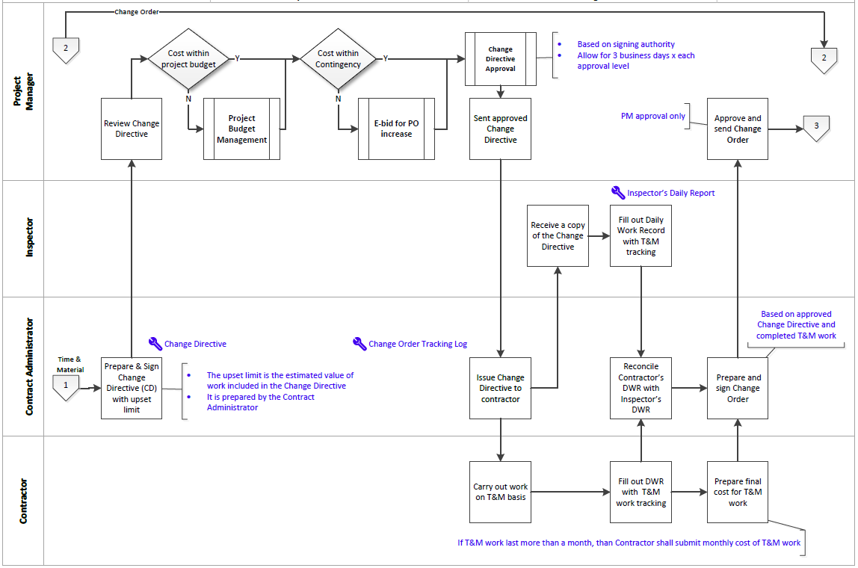
Change Management
Time and Materials > Change Directive
Independent validation of Contractor’s work on T&M basis by the site Inspector

Slide 5
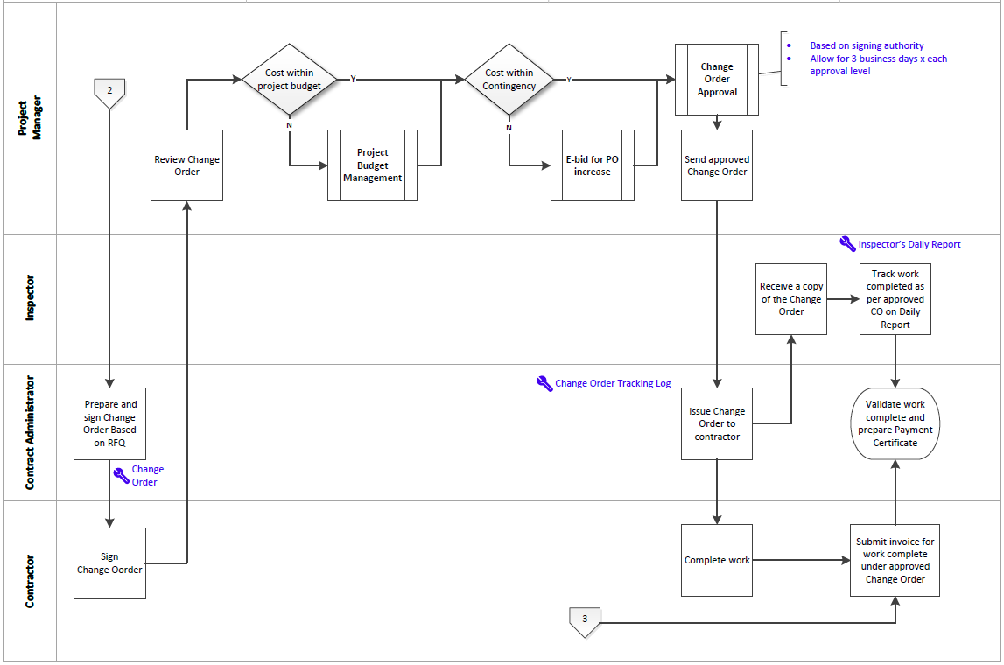
Change Management
RFQ (Fixed Cost / Lump Sum) > Change Order
Approved CO is an amendment to the contract
Confirm the scope of work included in the approved CO is complete
Only approved CO can be used for invoice payment

Slide 6
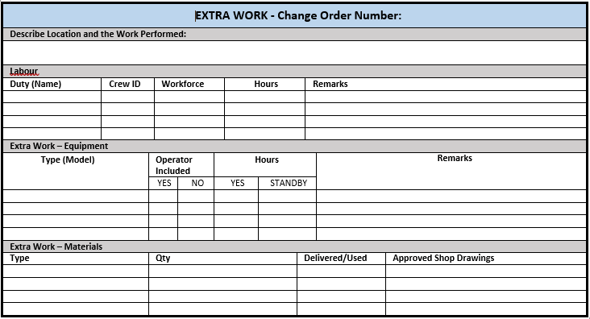
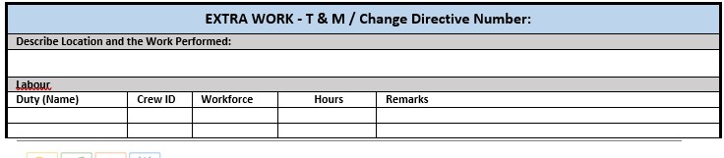
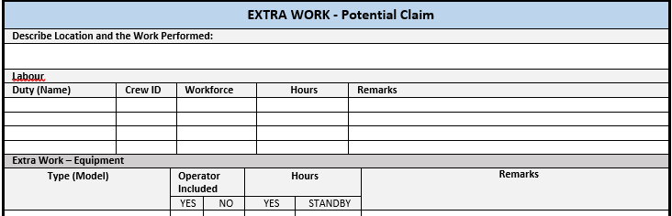
Change Management
Daily Inspection Report – New Template
Site Inspector independent tracking of Extra Work for Change Orders, Time & Material/Change Directive or Potential Claim

